Slide 1
JOURNEY PPT
Custom IDA
11 Sept 2023 – 15 Sept 2023
- Musaddiq Shariff

Slide 2
Week 4: Day -1
Doubt Solving session
Repetaition of Azure Data Factory
Hands-on on Azure Data Factory
loading the dataset into the storage account
Creation of pipeline
Fetching, updating rows of a table and getting affected in adf and datastorage
Creating the dataflow and cdc for the instances

Slide 3
Day – 2 Azure Synapse
Azure Synapse Analytics
Introduction to Azure Synapse Analytics
Mapping of data flow
Creation of pipeline, Data Ingestion and Preparation
Write and execute SQL queries
Understanding query performance optimization technique
Exploring the more options like manage, linked device creation
Explanation with theory and practical for all of the above concept

Slide 4
Day 3 Power Bi
Data Visualization using Power-Bi
Understanding and exploring about Power-Bi
Connecting to the various sources
Data load and transformation- removing duplicates, add column, slicers and group
Introduction to Dax and calculated column
Implicit and explicit measures
Row level security and aggregation function
Explanation with theory and practical for all of the above concept

Slide 5
Day 4 - Power-Bi cont..
Understanding various chart-type
Report and models
Dashboard
Hands-on
Recap
Scenario based chart preparation

Slide 6
Day 5 Python
Introduction to python
Variables, data types
Features of python
Creating a small data set
Exploring functions like zip,enumerate
Working on Lists, Dictionary, for-loop

Slide 7
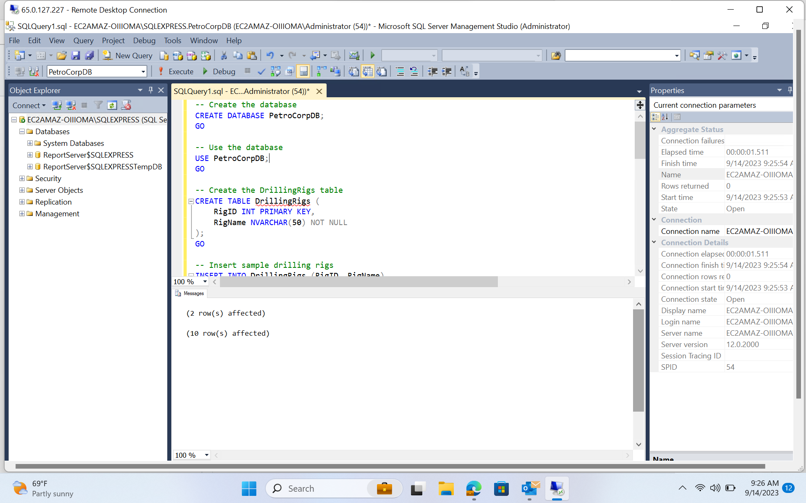
SQL Server

Slide 8
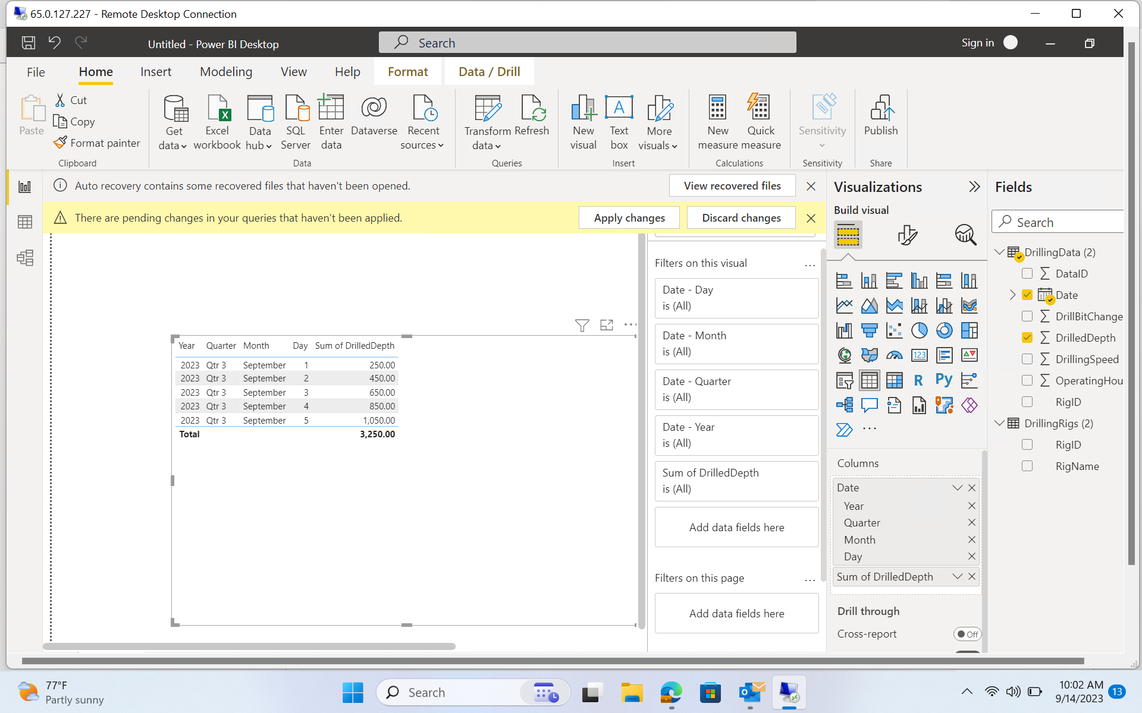
Power Bi

Slide 9
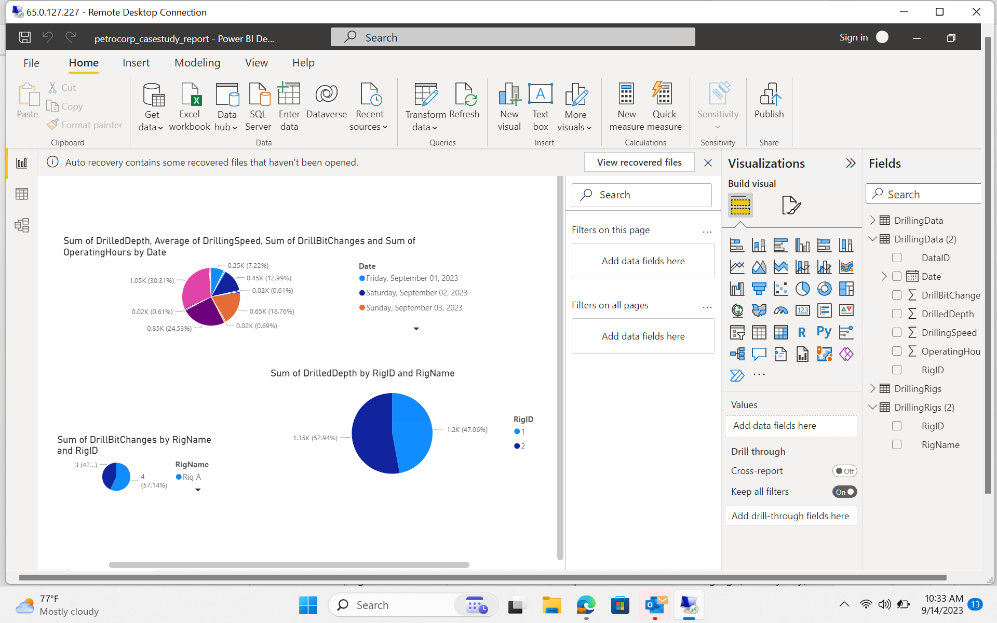
Power Bi

Slide 10
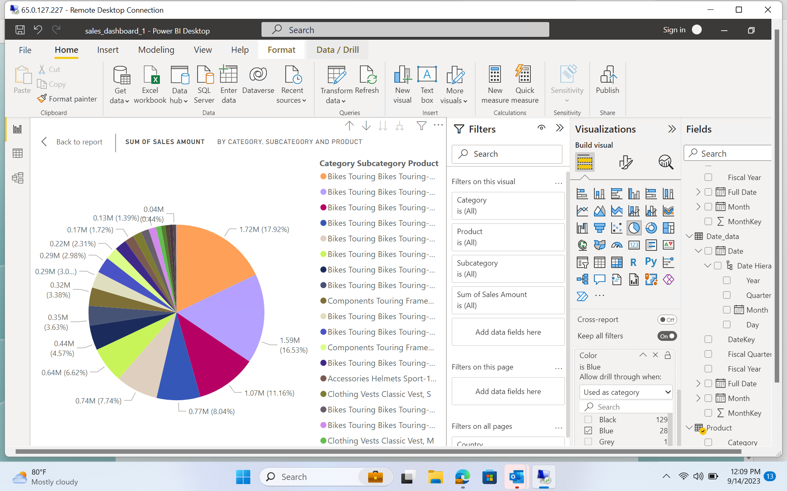
Power Bi

Slide 11
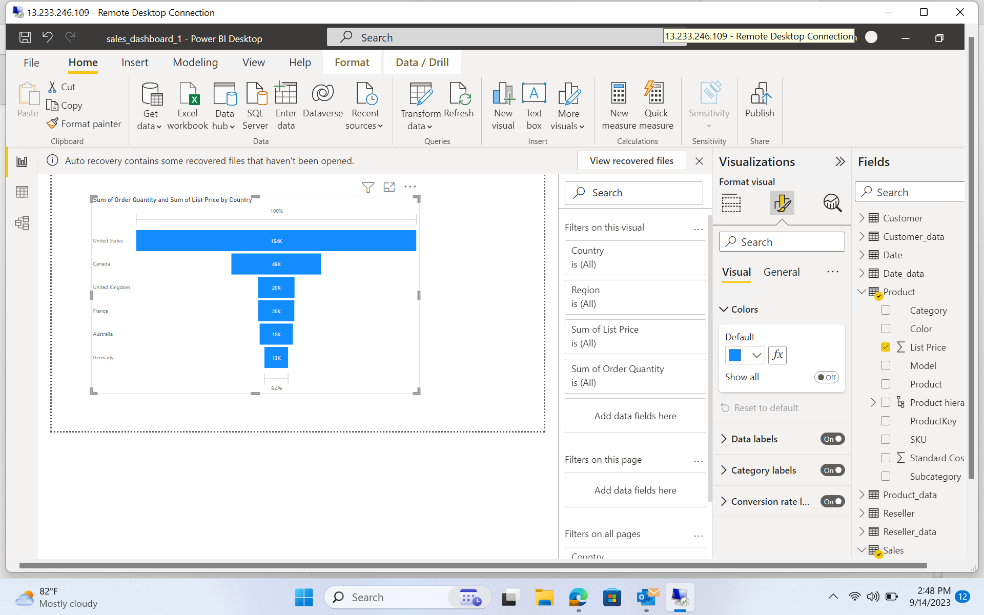
Power Bi

Slide 12
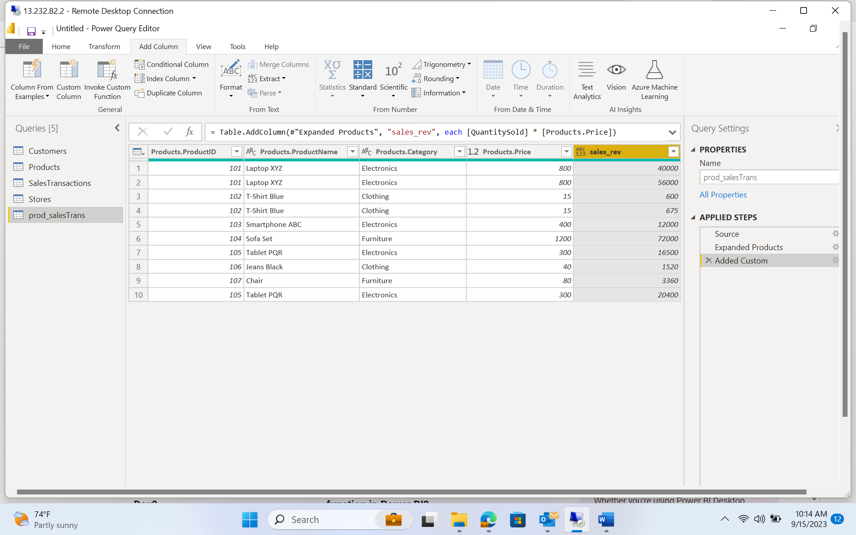
Power Bi

Slide 13
Power Bi

Slide 14
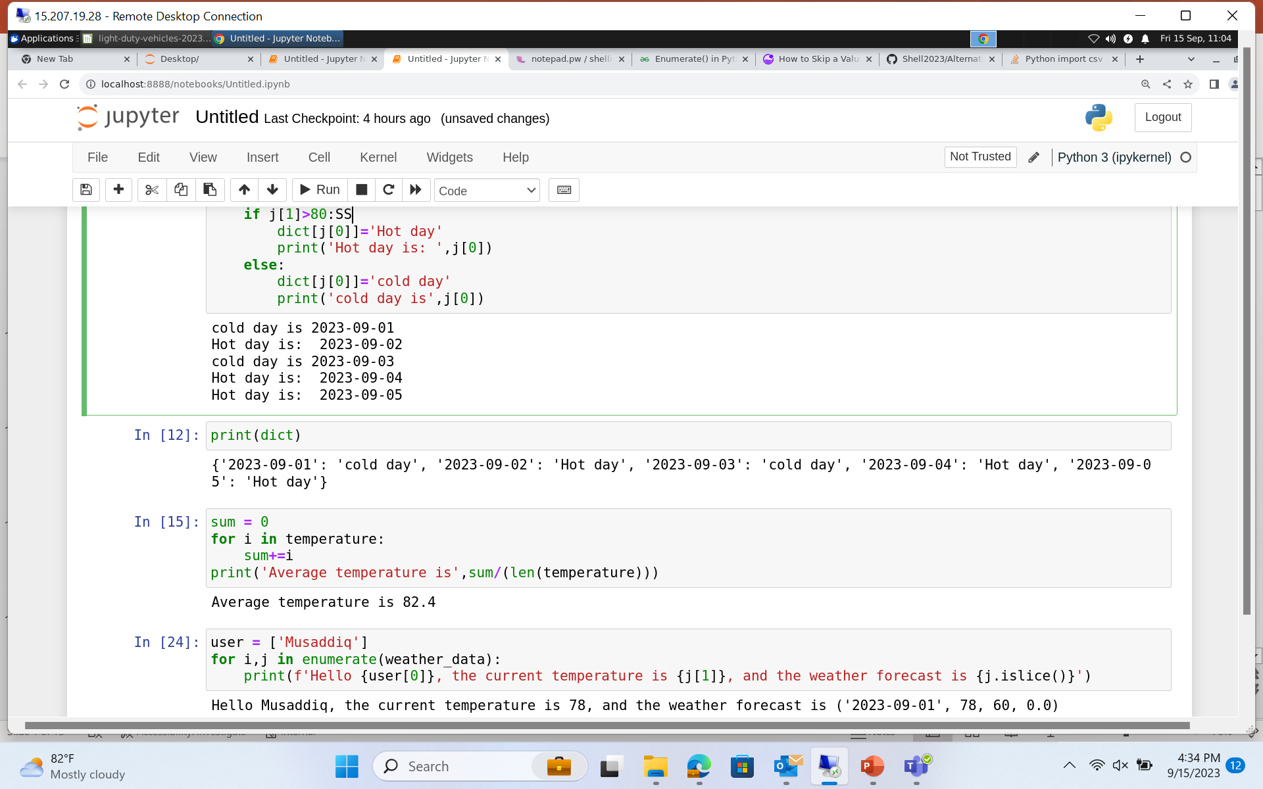
Jupyter Notebook

Slide 15
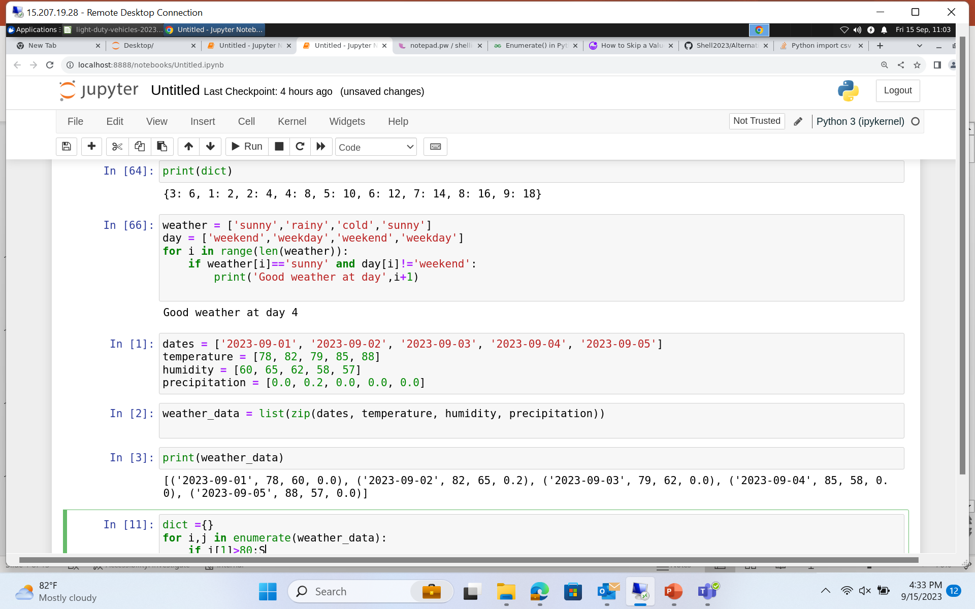
Jupyter Notebook

